Slide 1

22년 삼성 AI 전문가과정
6월 8일 수요일 6교시
장병탁
인공지능
15차시 : Machine Learning
서울대학교 컴퓨터공학부
담당 교수: 장병탁
Seoul National University
Byoung-Tak Zhang

Slide 2
Lecture Overview
인공지능
15차시 : Machine Learning
서울대학교 컴퓨터공학부
담당 교수: 장병탁
Seoul National University
Byoung-Tak Zhang

Slide 3
Introduction: Machine Learning
Knowledge Representation and Reasoning (Previous lectures)
How to build a model of the world (or to represent the knowledge about the world).
How to make inferences (using the model) to predict the world
The models (or representations) were usually designed or built manually (not automatically).
Machine Learning (This lecture)
We describe agents that can improve their behavior through diligent study of past experiences and predictions about the future.
Machine learning builds the models (or representations) automatically from data.
Decision trees, linear models, nonparametric models, ensemble models, etc.
Why we care about machine learning?
The designers cannot anticipate all possible future situations
Sometimes the designers have no idea how to program a solution themselves

Slide 4

Learning Tasks
Forms of learning: Feedbacks to learn from Text
Unsupervised learning: learns patterns in the input without explicit feedback, such as clustering
Reinforcement learning: learns from a series of reinforcements – rewards or punishments
Supervised learning: observes some example input-output pairs and learn a function that maps from input to output
Semisupervised learning: given a few labeled examples and a large collection of unlabeled examples
Google. (n.d.). Google search. Retrieved February 25, 2022, from https://www.google.com/search?q=machine%2Blearning&source=lnms&tbm=isch&sa=X&ved=2ahUKEwj2ht_t8Zr2AhXLDt4KHcSYCBQQ_AUoAXoECAIQAw#imgrc=AS58sENCemFFvM

Slide 5
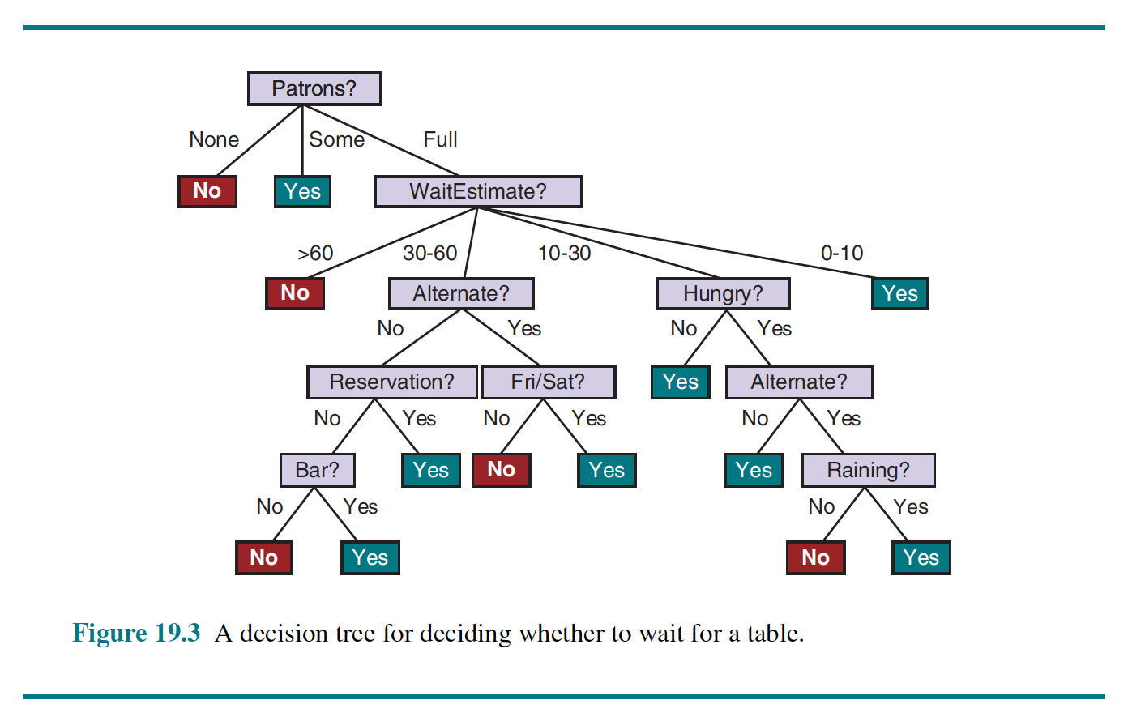
Learning Models
Decision Trees (DT)
Neural Networks (NN)

Slide 6
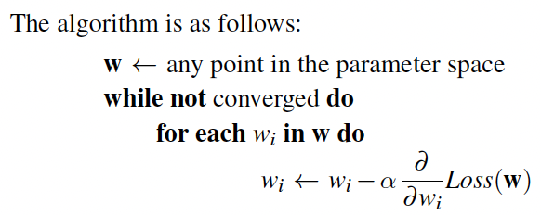
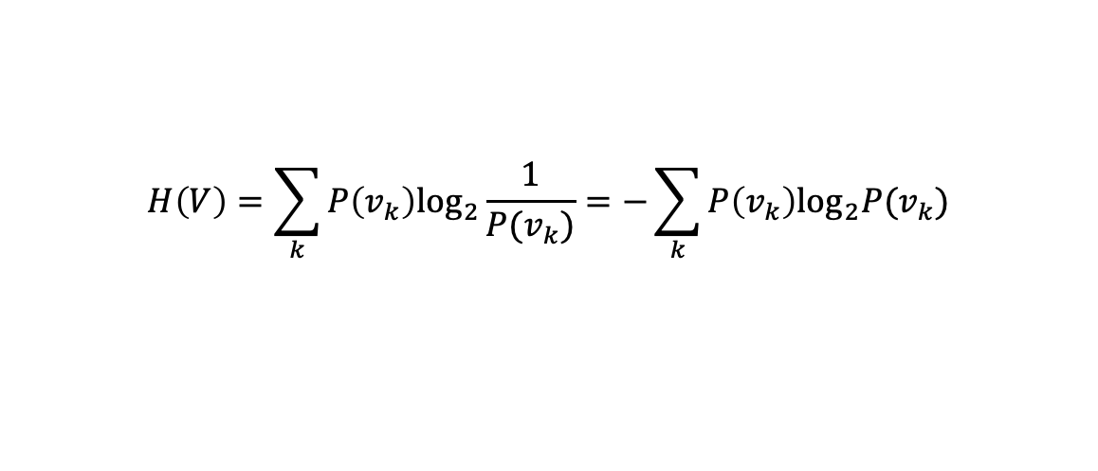
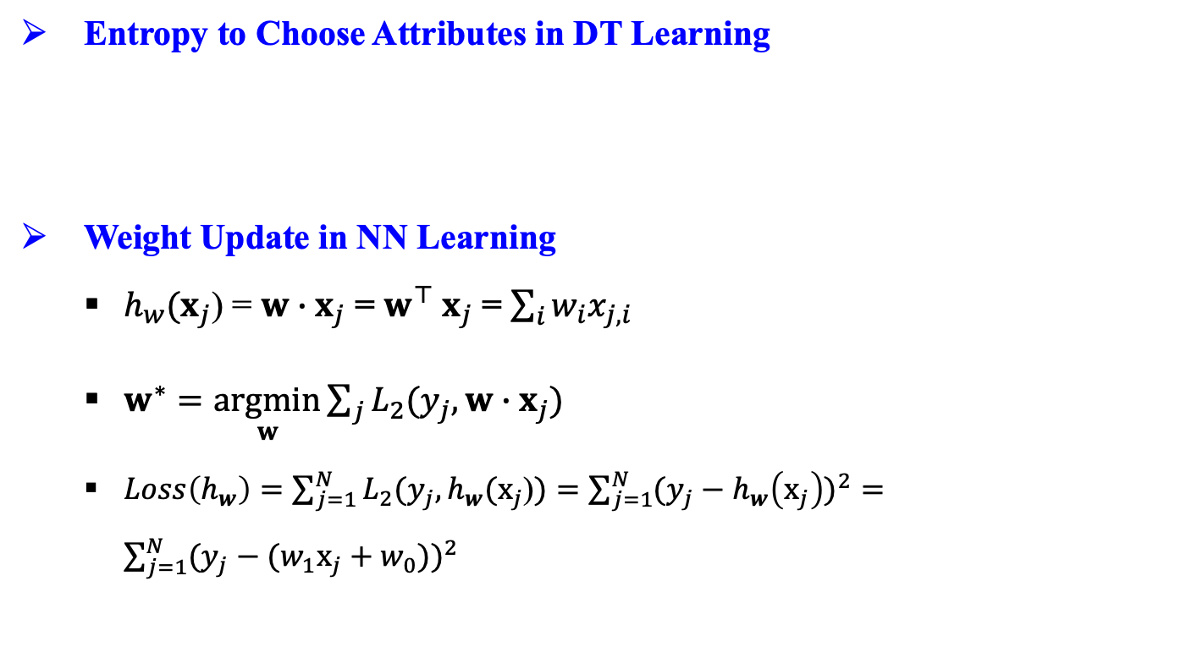
Learning Algorithms
Entropy to Choose Attributes in DT Learning
Weight Update in NN Learning
$h_{w}(x_{j}$) = $w∙x_{j}$ = $w^{⊤}$ $x_{j}$ = $\sum_{i}{w_{i}x_{j,i}}$
$w^{∗}=\underset{w}{argmin}{\sum_{j}{L_{2}(y_{j},w∙x_{j})}}$
$Loss\left(h_{w}\right)=\sum_{j=1}^{N}{L_{2}(y_{j},h_{w}(x_{j}\text{)})}=\sum_{j=1}^{N}{{(y_{j}−h_{w}\left(x_{j}\right))}^{2}}=\sum_{j=1}^{N}{{(y_{j}−(w_{1}x_{j}+w_{0}))}^{2}}$
$$H\left(V\right)=\sum_{k}{P\left(v_{k}\right){\text{log}}_{2}\frac{1}{P(v_{k})}}=−\sum_{k}{P\left(v_{k}\right){\text{log}}_{2}P(v_{k})}$$

Slide 7
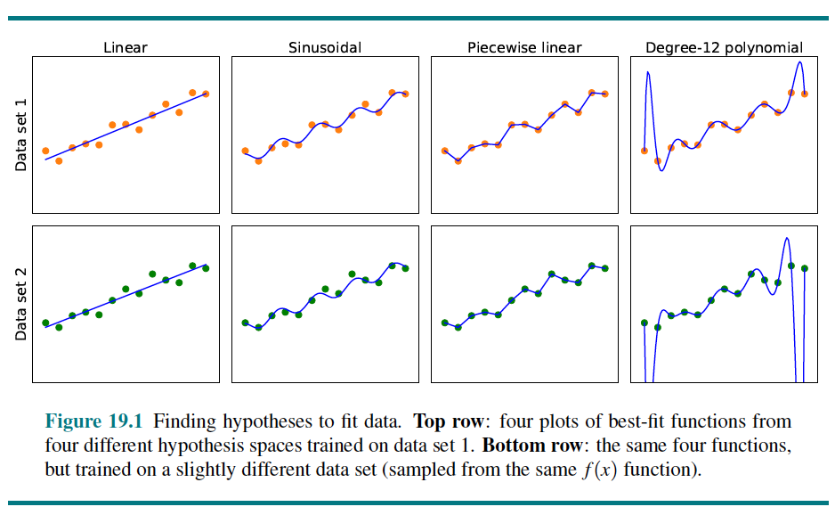
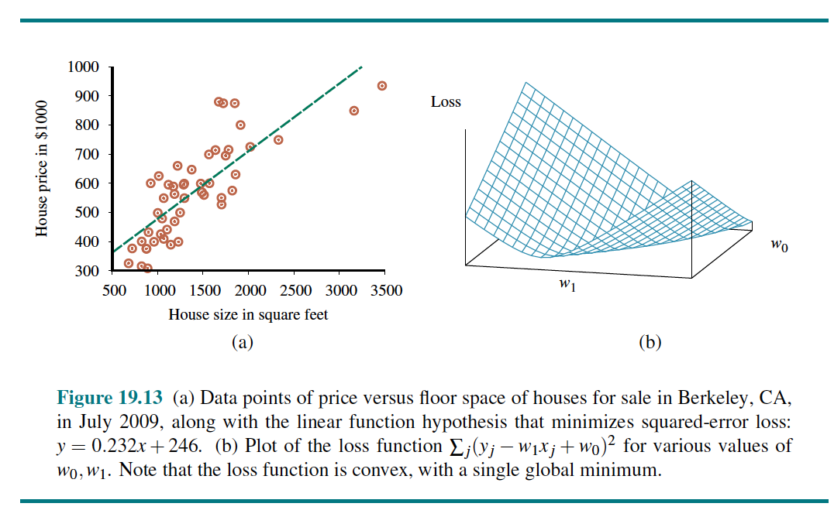
Lecture 15. Machine Learning
Forms of Learning
Agent components, Representation and prior knowledge
Supervised Learning
Classification, Regression
Learning Decision Trees
Boolean decision tree, Entropy
Information gain
The Theory of Learning
Probably approximately correct
Linear Regression and Classification
Univariate, Multivariable linear regression, Gradient descent
Nonparametric Models
Nearest-neighbor models, SVM
Ensemble Learning
Bagging, Random forests, Stacking, Boosting
<출처> Stuart J. Russell and Peter Norvig (2021). Artificial Intelligence: A Modern Approach (4th Edition). Pearson

Slide 8
Outline (Lecture 15)
15.1 Forms of Learning ……………………………………….
15.2 Supervised Learning ……………………………………..
15.3 Learning Decision Trees .……………................................
15.4 The Theory of Learning ………........................................
15.5 Linear Regression and Classification ……………………..
15.6 Nonparametric Models …………………………………...
15.7 Ensemble Learning ………………………………………..
Summary ……………………………………………………….
8
11
16
23
27
38
45
53

Slide 9
15.1 Forms of Learning

Slide 10
15.1 Forms of Learning (1/2)
This chapter assumes little prior knowledge on the part of the agent.
Later we will consider transfer learning, in which knowledge from one domain is transferred to a new domain so that learning can proceed faster with less data.
This chapter concentrates on the problems with
Inputs: factored representation – a vector of attribute values
Outputs: discrete values (classification) or continuous numerical values (regression)
Classification: the output is one of a finite set of values (sunny/cloudy/rainy or true/false)
Regression: When the output is a number (such as tomorrow’s temperature, measured either as an integer or a real number)
Inductive learning: learning a general function or rule from specific input-output pairs
Analytical or deductive learning: going from a known general rule to a new rule that is logically entailed

Slide 11
15.1 Forms of Learning (2/2)
Feedback to learn from
Unsupervised learning: learns patterns in the input without explicit feedback, such as clustering
Reinforcement learning: learns from a series of reinforcements – rewards or punishments
Supervised learning: observes some example input-output pairs and learn a function that maps from input to output
Semisupervised learning: given a few labeled examples and a large collection of unlabeled examples
Google. (n.d.). Google search. Retrieved February 25, 2022

Slide 12
15.2 Supervised Learning

Slide 13
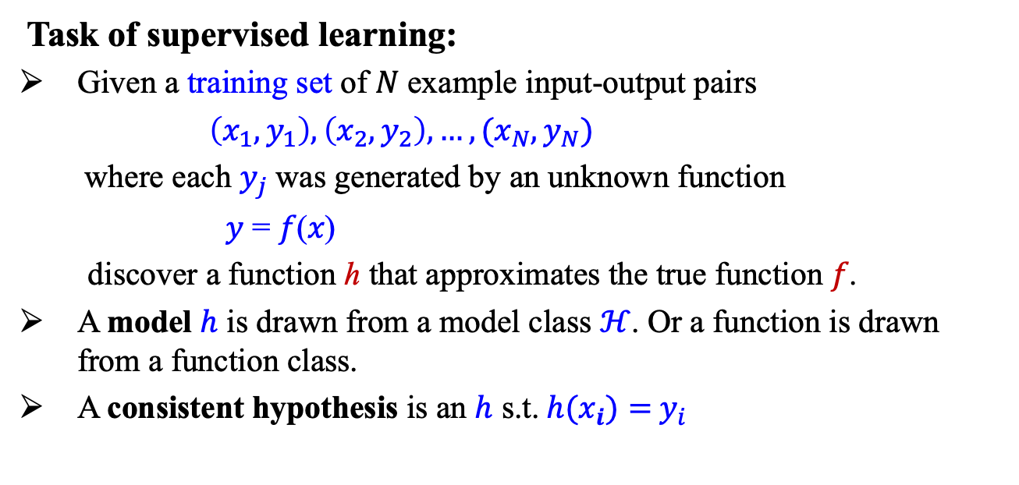
15.2 Supervised Learning (1/4)
Task of supervised learning:
Given a training set of 𝑁 example input-output pairs
$\left(x_{1}, y_{1}\right), \left(x_{2}, y_{2}\right),…,(x_{N}, y_{N})$
where each $y_{j}$was generated by an unknown function
𝑦 = 𝑓(𝑥)
discover a function ℎ that approximates the true function 𝑓.
A model $h$ is drawn from a model class $ℋ$. Or a function is drawn from a function class.
A consistent hypothesis is an $h$ s.t.${h(x}_{i})={ y}_{i}$
Classification: discrete y
Regression: continuous y

Slide 14
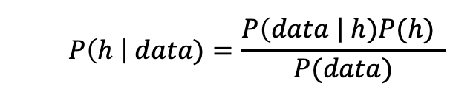
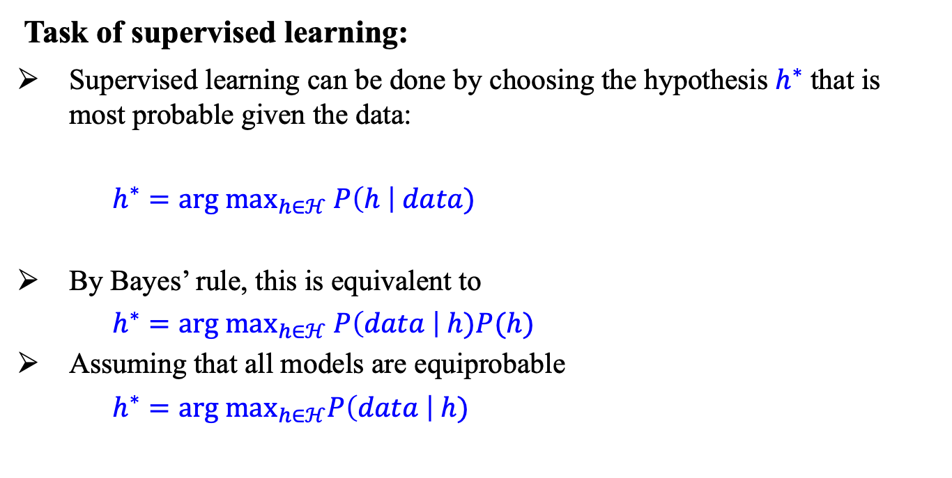
15.2 Supervised Learning (2/4)
Task of supervised learning:
Supervised learning can be done by choosing the hypothesis $h^{∗}$ that is most probable given the data:
$h^{∗}={arg max}_{h∈ℋ} P\left(h \right| data)$
By Bayes’ rule, this is equivalent to
$h^{∗}={arg max}_{h∈ℋ} P\left(data \right| h)P(h)$
Assuming that all models are equiprobable
$h^{∗}={arg max}_{h∈ℋ}P\left(data \right| h)$
$$P\left(h \right| data)=\frac{P\left(data \right| h)P(h) }{P(data)}$$
(MAP, Maximum A Posteriori Estimation)
(MLE, Maximum Likelihood Estimation)

Slide 15
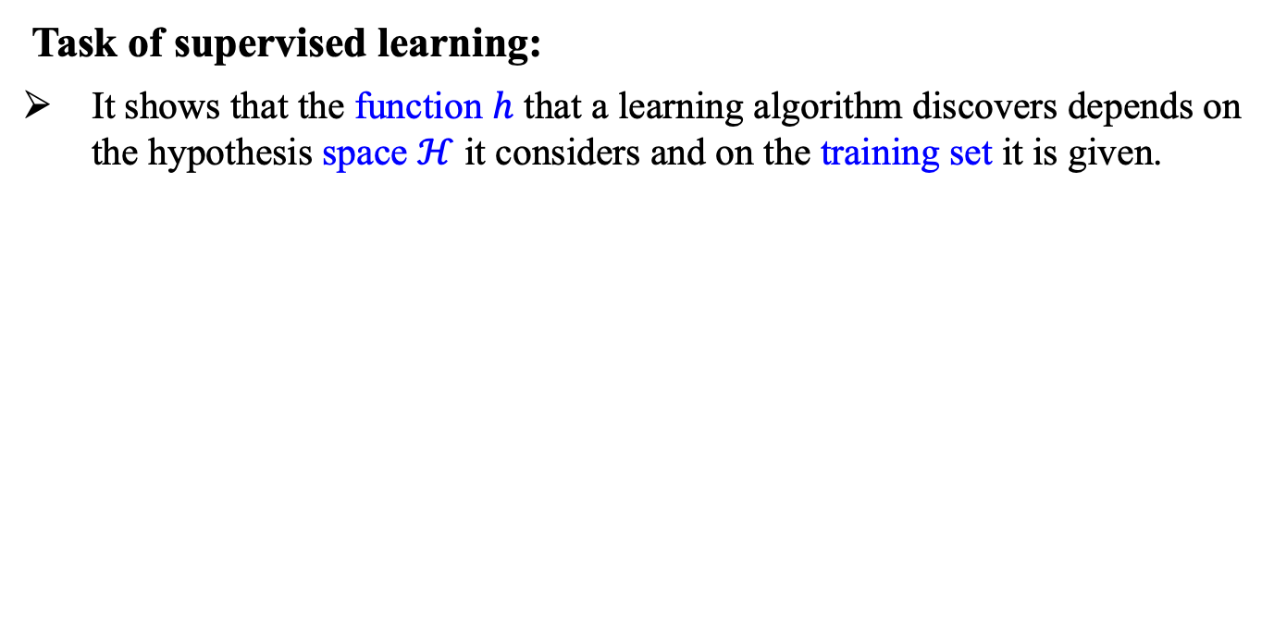
15.2 Supervised Learning (3/4)
Task of supervised learning:
It shows that the function $h$ that a learning algorithm discovers depends on the hypothesis space $ℋ$ it considers and on the training set it is given.

Slide 16
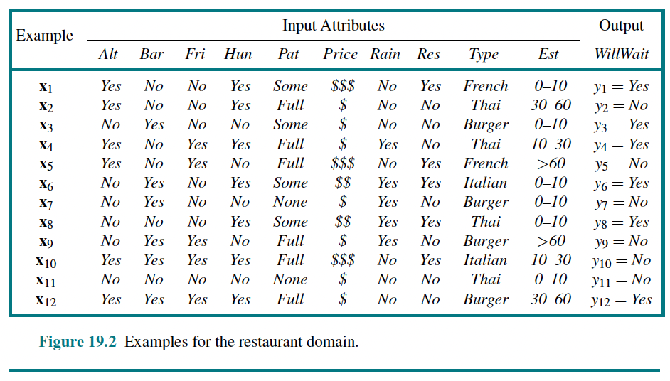
15.2 Supervised Learning (4/4)
Example problem: Restaurant waiting
The problem of deciding whether to wait for a table at a restaurant based on the supervised learning

Slide 17
15.3 Learning Decision Trees

Slide 18
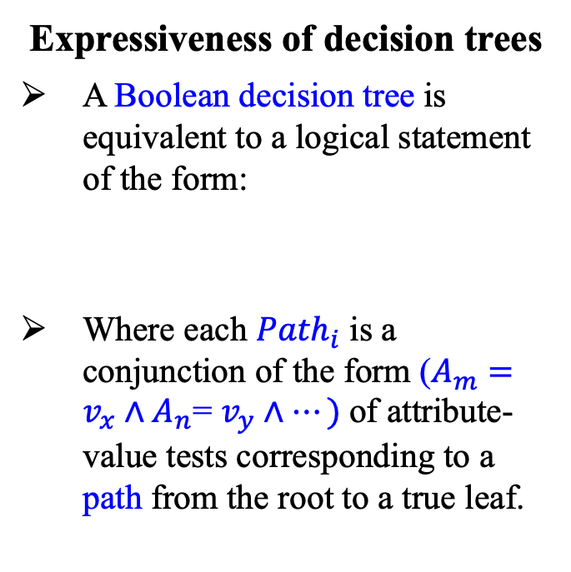
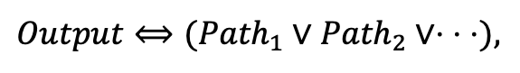
15.3 Learning Decision Trees (1/6)
Expressiveness of decision trees
A Boolean decision tree is equivalent to a logical statement of the form:
Where each ${Path}_{i}$ is a conjunction of the form ($A_{m}=v_{x}∧A_{n}$= $v_{y}∧⋯)$of attribute-value tests corresponding to a path from the root to a true leaf.
$Output⟺({Path}_{1}∨{Path}_{2}∨⋅$ $⋅$ $⋅$),
<출처> Stuart J. Russell and Peter Norvig (2021). Artificial Intelligence: A Modern Approach (4th Edition). Pearson

Slide 19
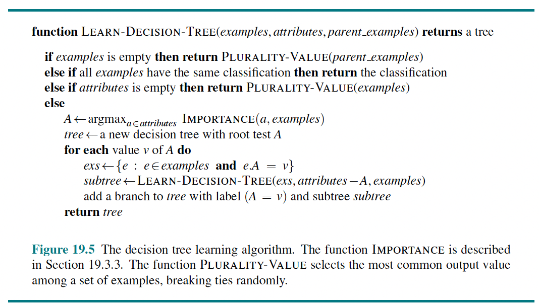
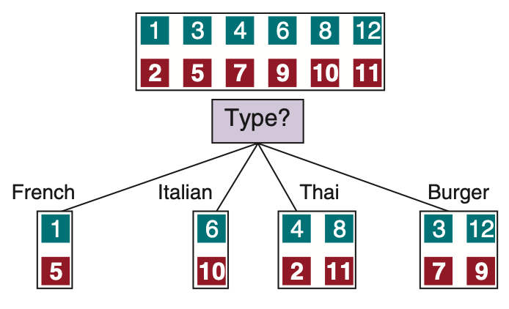
15.3 Learning Decision Trees (2/6)
An algorithm for learning decision trees
<출처> Stuart J. Russell and Peter Norvig (2021). Artificial Intelligence: A Modern Approach (4th Edition). Pearson

Slide 20
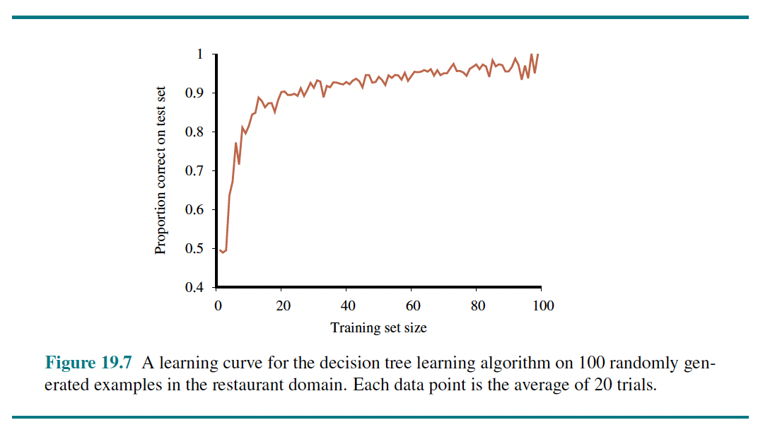
15.3 Learning Decision Trees (3/6)
We can evaluate the performance of a learning algorithm with a learning curve, as shown below
As the training set size grows, the accuracy increases (happy graphs)
<출처> Stuart J. Russell and Peter Norvig (2021). Artificial Intelligence: A Modern Approach (4th Edition). Pearson

Slide 21
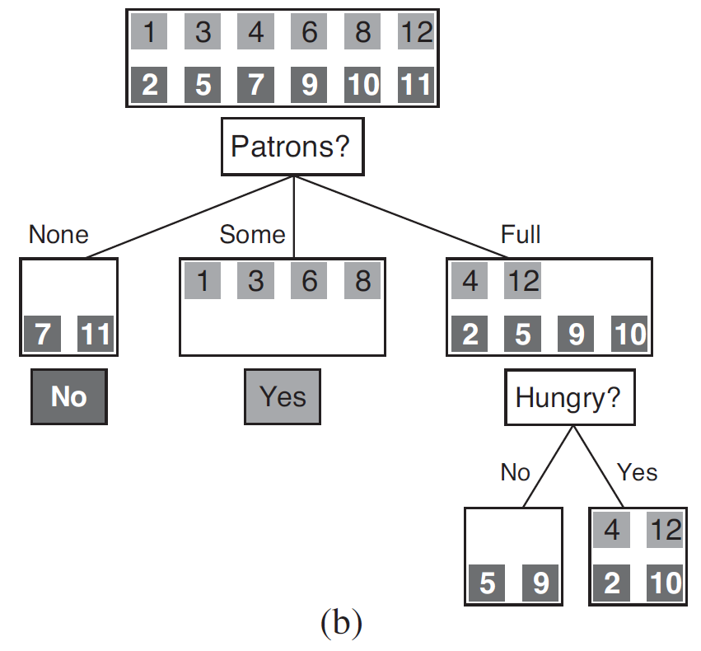
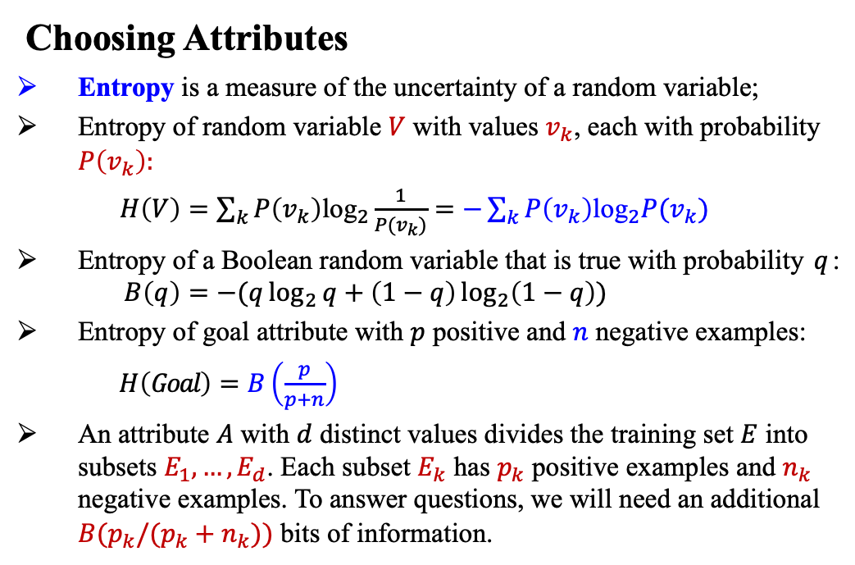
15.3 Learning Decision Trees (4/6)
Choosing Attributes
Entropy is a measure of the uncertainty of a random variable;
Entropy of random variable $V$ with values $v_{k}$, each with probability $P\left(v_{k}\right):$
$H\left(V\right)=\sum_{k}{P\left(v_{k}\right){\text{log}}_{2}\frac{1}{P(v_{k})}}=−\sum_{k}{P\left(v_{k}\right){\text{log}}_{2}P(v_{k})}$
Entropy of a Boolean random variable that is true with probability $q$:
$$B\left(q\right)=−(q\log_{2}{q}+\left(1−q\right)\log_{2}\left(1−q\right))$$
Entropy of goal attribute with $p$ positive and $n$ negative examples:
$H\left(Goal\right)=B\left(\frac{p}{p+n}\right)$
An attribute $A$ with $d$ distinct values divides the training set $E$ into subsets $E_{1},…, E_{d}$. Each subset $E_{k}$ has $p_{k}$ positive examples and $n_{k}$ negative examples. To answer questions, we will need an additional ${B(p}_{k}/(p_{k}+n_{k}))$ bits of information.
<출처> Stuart J. Russell and Peter Norvig (2016). Artificial Intelligence: A Modern Approach (3rd Edition). Pearson

Slide 22
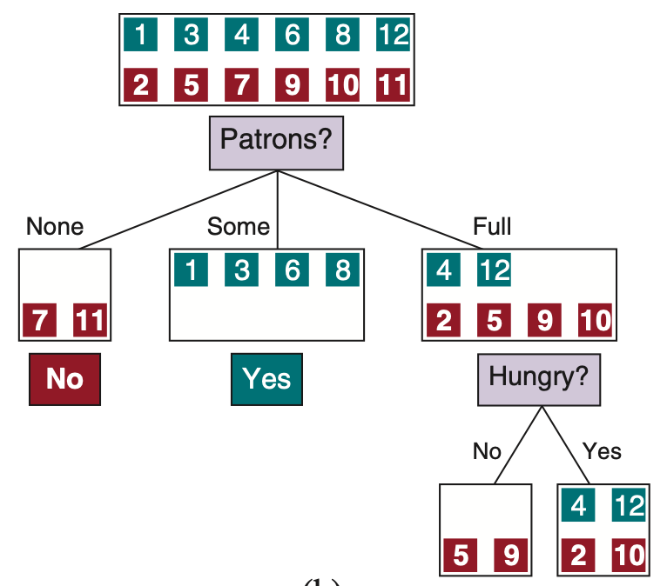
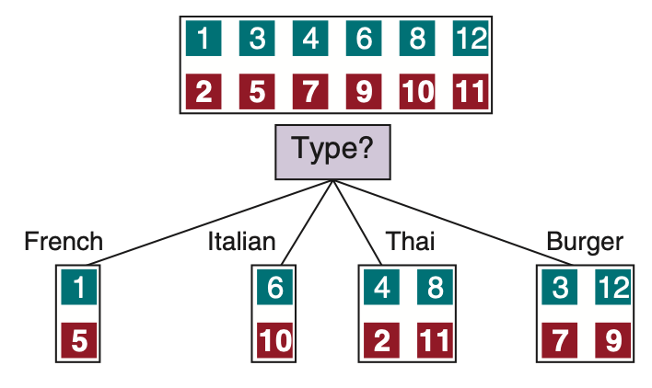
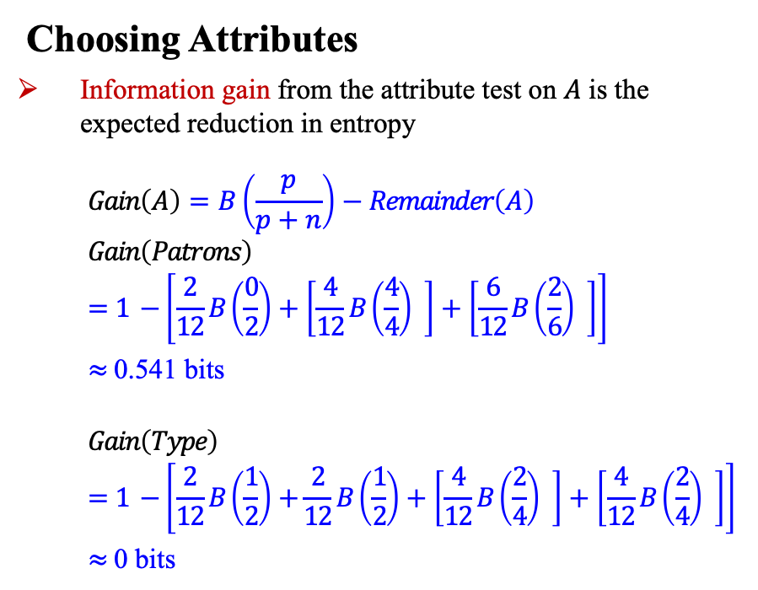
15.3 Learning Decision Trees (5/6)
Choosing Attributes
Information gain from the attribute test on $A$ is the expected reduction in entropy
$$Gain\left(A\right)=B\left(\frac{p}{p+n}\right)−Remainder\left(A\right)$$
$$Gain\left(Patrons\right)$$
$$=1 −\left[\frac{2}{12}B\left(\frac{0}{2}\right)+\left[\frac{4}{12}B\left(\frac{4}{4}\right) \right]+\left[\frac{6}{12}B\left(\frac{2}{6}\right) \right]\right]$$
$≈$ 0.541 bits
$$Gain\left(Type\right)$$
$$=1 −\left[\frac{2}{12}B\left(\frac{1}{2}\right)+\frac{2}{12}B\left(\frac{1}{2}\right)+\left[\frac{4}{12}B\left(\frac{2}{4}\right) \right]+\left[\frac{4}{12}B\left(\frac{2}{4}\right) \right]\right]$$
$≈$ 0 bits

Slide 23
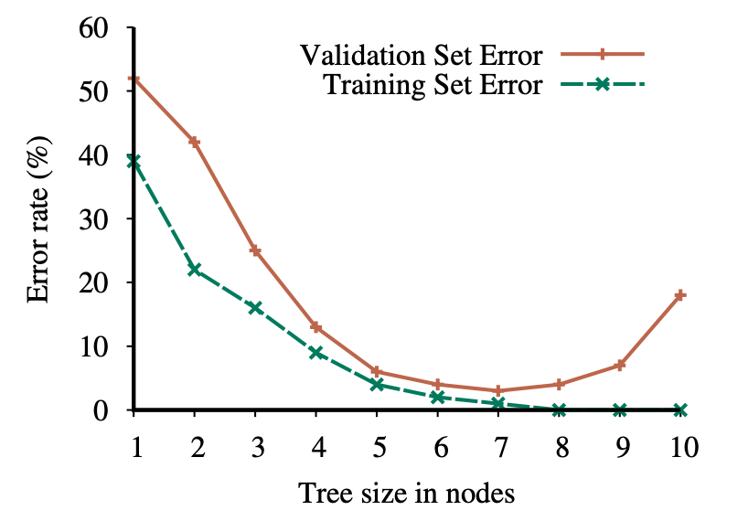
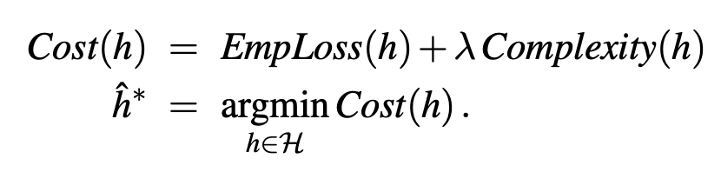
15.3 Learning Decision Trees (6/6)
Overfitting and Regularization
Overfitting becomes more likely as the hypothesis space and the number of input attributes grows, and less likely as we increase the number of training examples
Decision tree pruning combats overfitting
Regularization:

Slide 24
15.4 The Theory of Learning

Slide 25
15.4 The Theory of Learning (1/3)
Learning curves are useful, but they are specific to a particular learning algorithm on a particular problem.
Are there some more general principles governing the number of examples needed?
Computational learning theory
Probably approximately correct (PAC)
Any hypothesis that is consistent with a sufficiently large set of training examples is unlikely to be seriously wrong: that is, it must be probably approximately correct (PAC).
Any learning algorithm that returns hypotheses that are probably approximately correct is called a PAC learning algorithm;
We can use this approach to provide bounds on the PAC learning performance of various learning algorithms.

Slide 26
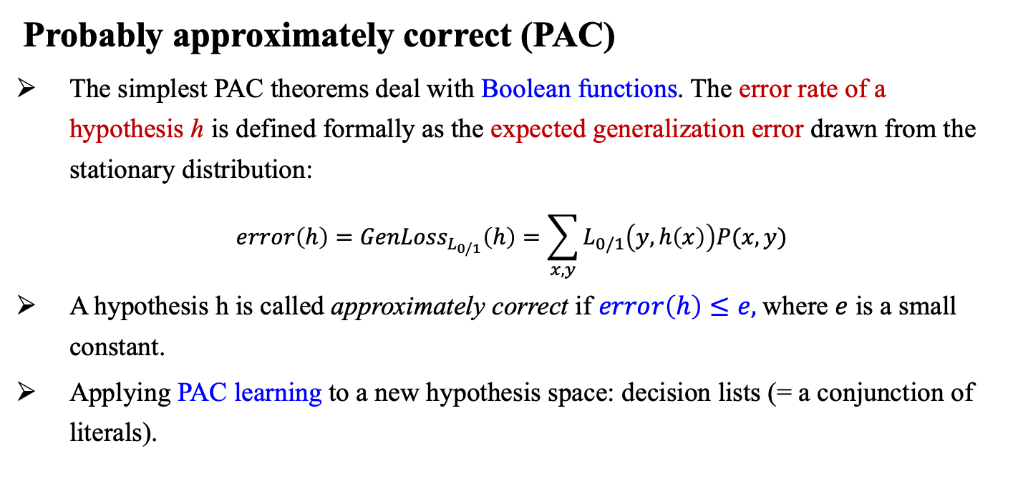
15.4 The Theory of Learning (2/3)
Probably approximately correct (PAC)
The simplest PAC theorems deal with Boolean functions. The error rate of a hypothesis h is defined formally as the expected generalization error drawn from the stationary distribution:
$$error\left(h\right)={GenLoss}_{L_{0/1}}\left(h\right)=\sum_{x,y}{L_{0/1}\left(y,h\left(x\right)\right)P(x,y)}$$
A hypothesis h is called approximately correct if $error\left(h\right)≤e,$where $e$ is a small constant.
Applying PAC learning to a new hypothesis space: decision lists (= a conjunction of literals).
<출처> Stuart J. Russell and Peter Norvig (2021). Artificial Intelligence: A Modern Approach (4th Edition). Pearson

Slide 27
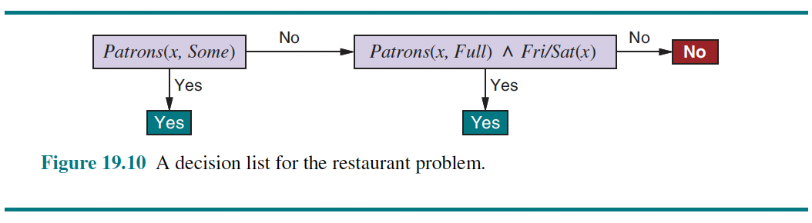
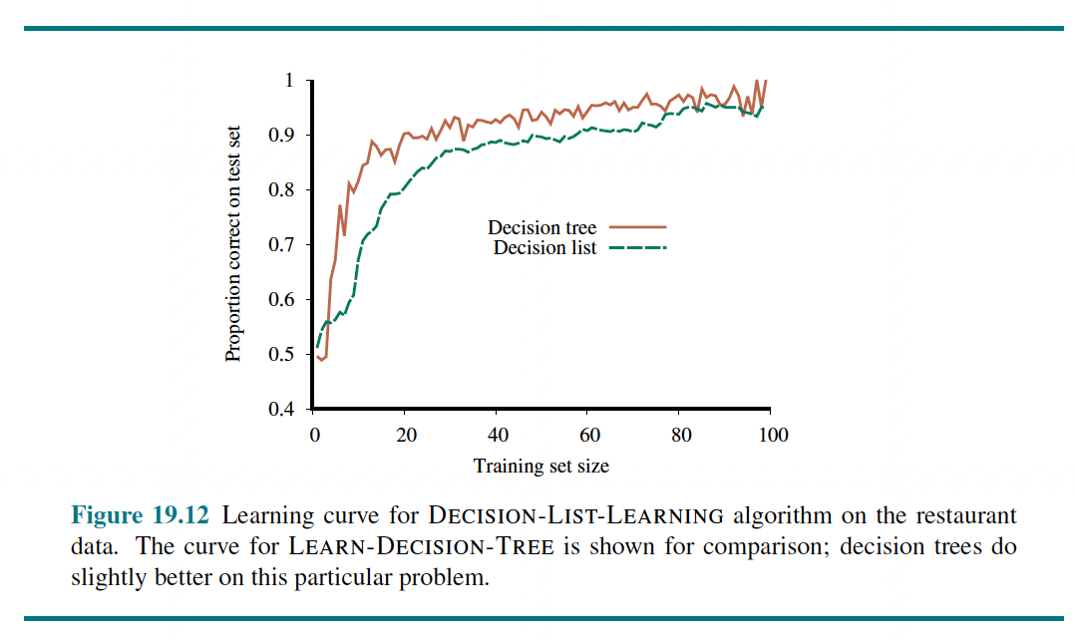
15.4 The Theory of Learning (3/3)
Probably approximately correct (PAC)
Learning decision lists
<출처> Stuart J. Russell and Peter Norvig (2021). Artificial Intelligence: A Modern Approach (4th Edition). Pearson

Slide 28
15.5 Linear Regression and
Classification

Slide 29
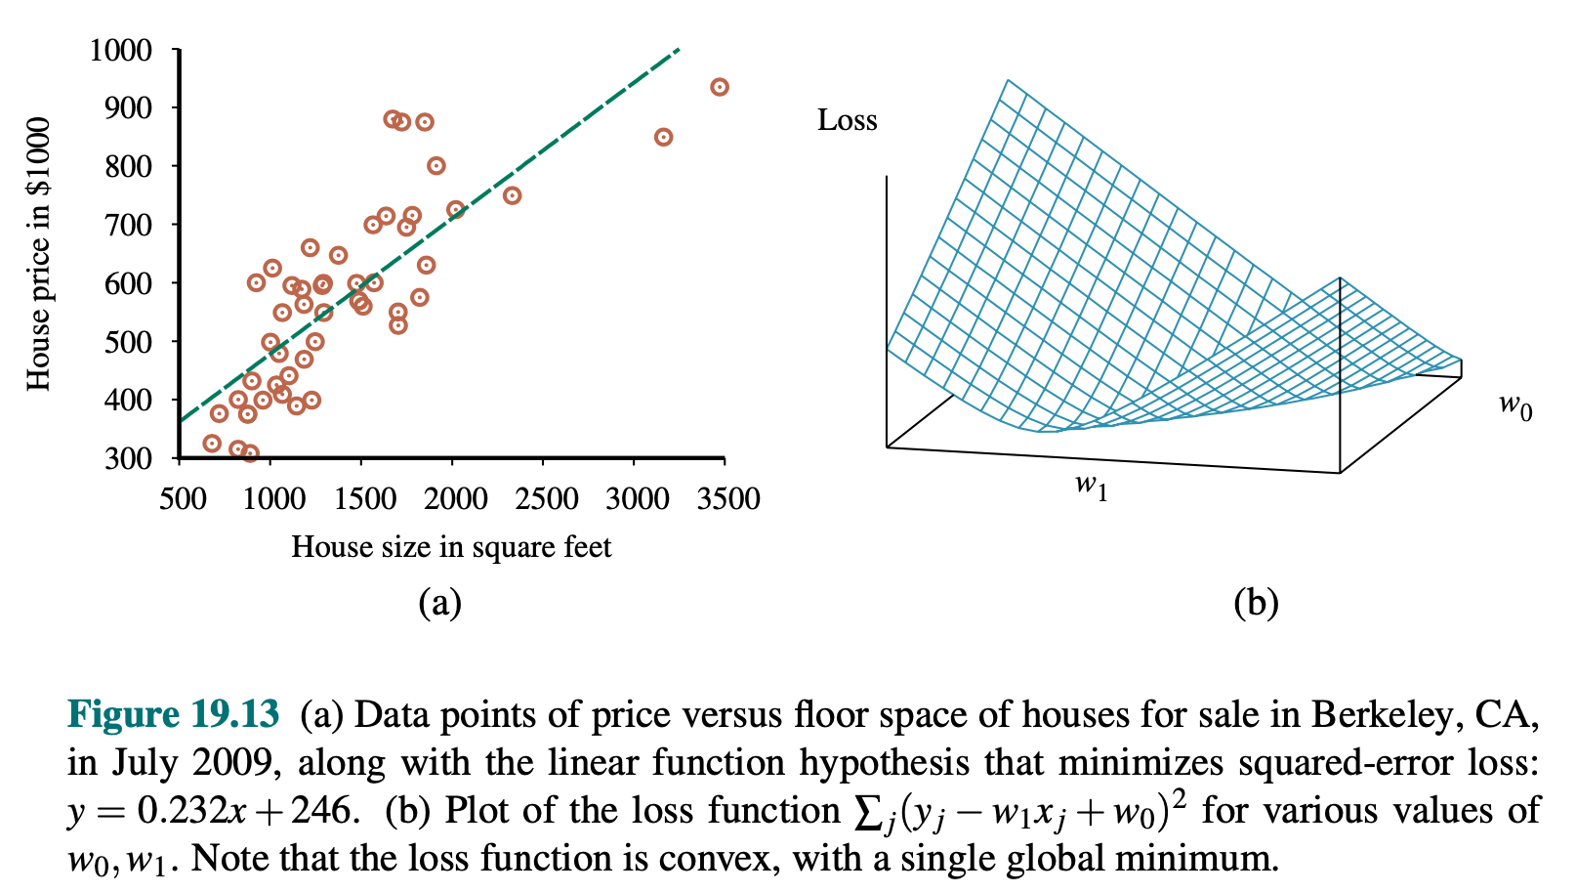
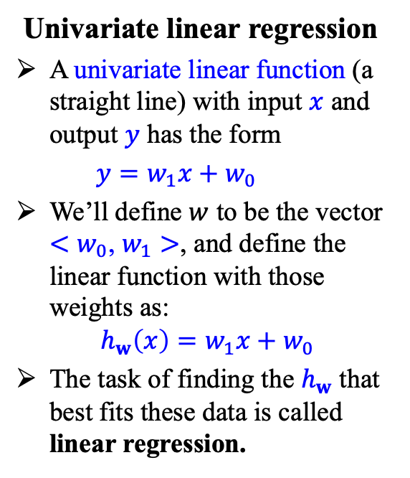
15.5 Linear Regression and Classification (1/10)
Univariate linear regression
A univariate linear function (a straight line) with input $x$ and output $y$ has the form
$y=w_{1}x+w_{0}$
We’ll define $w$ to be the vector ${<w}_{0}$, $w_{1}>$, and define the linear function with those weights as:
$$h_{w}\left(x\right)=w_{1}x+w_{0}$$
The task of finding the $h_{w}$ that best fits these data is called linear regression.

Slide 30
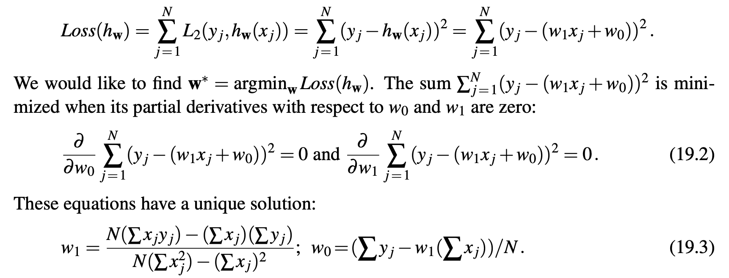
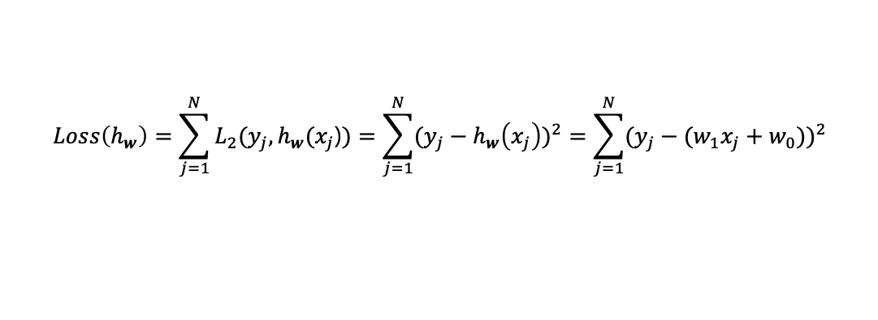
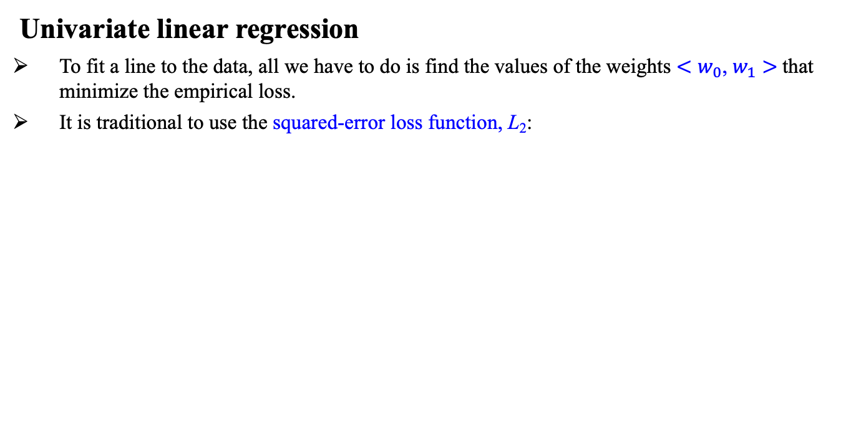
15.5 Linear Regression and Classification (2/10)
Univariate linear regression
To fit a line to the data, all we have to do is find the values of the weights ${<w}_{0}$, $w_{1}>$that minimize the empirical loss.
It is traditional to use the squared-error loss function, L₂:
$$Loss\left(h_{w}\right)=\sum_{j=1}^{N}{L_{2}(y_{j},h_{w}(x_{j}\text{)})}=\sum_{j=1}^{N}{{(y_{j}−h_{w}\left(x_{j}\right))}^{2}}=\sum_{j=1}^{N}{{(y_{j}−(w_{1}x_{j}+w_{0}))}^{2}}$$

Slide 31
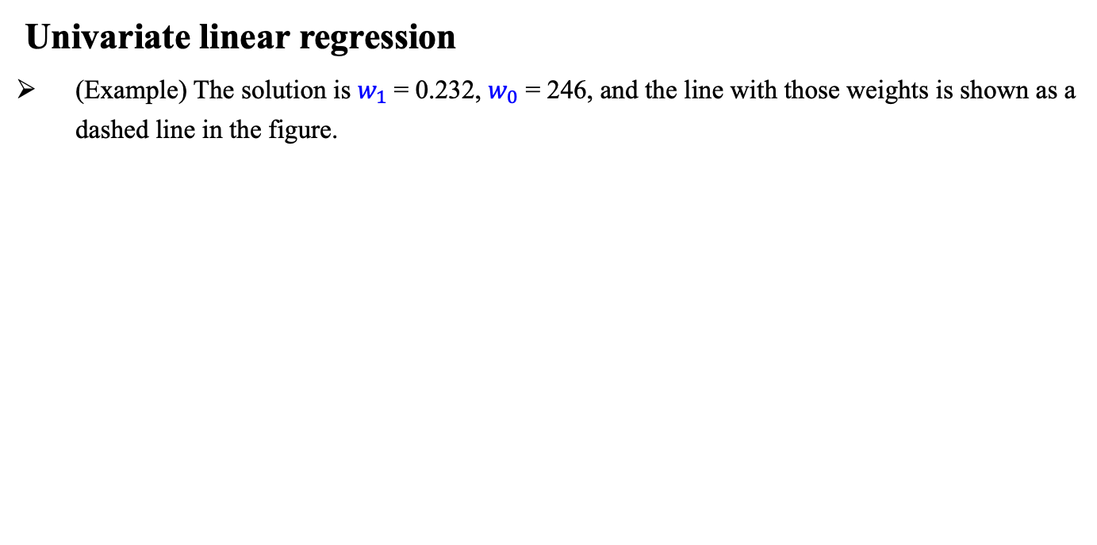
15.5 Linear Regression and Classification (3/10)
Univariate linear regression
(Example) The solution is $w_{1}$= 0.232, $w_{0}$ = 246, and the line with those weights is shown as a dashed line in the figure.
<출처> Stuart J. Russell and Peter Norvig (2021). Artificial Intelligence: A Modern Approach (4th Edition). Pearson

Slide 32
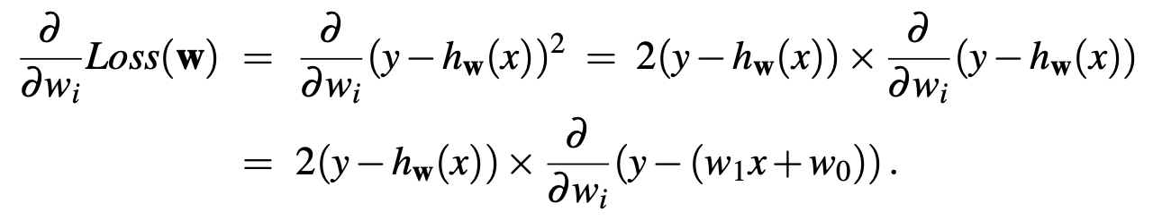
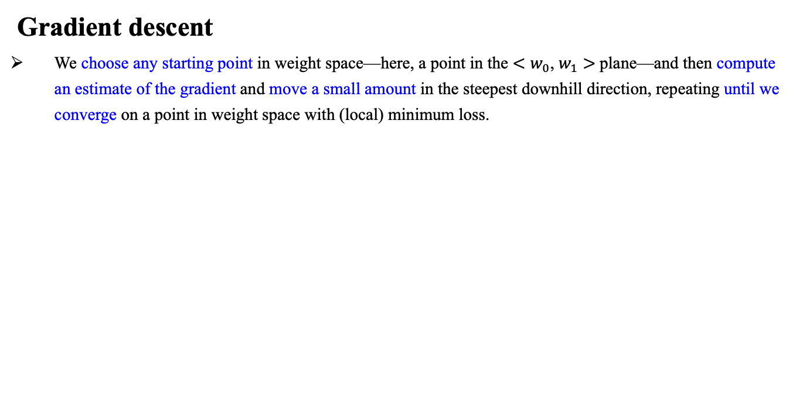
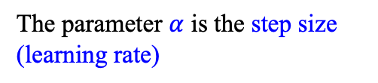
15.5 Linear Regression and Classification (4/10)
Gradient descent
We choose any starting point in weight space—here, a point in the ${<w}_{0}$, $w_{1}>$plane—and then compute an estimate of the gradient and move a small amount in the steepest downhill direction, repeating until we converge on a point in weight space with (local) minimum loss.
The parameter $α$ is the step size (learning rate)

Slide 33
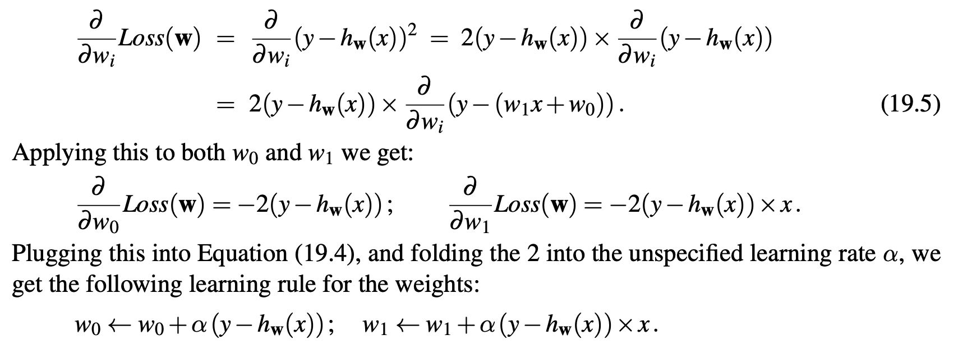
15.5 Linear Regression and Classification (5/10)
Gradient descent (cont’d)

Slide 34
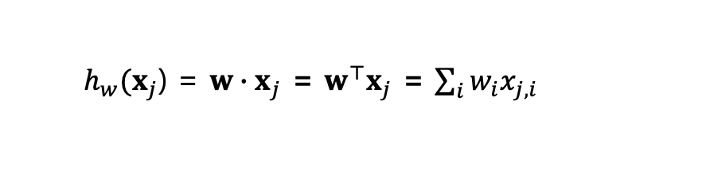
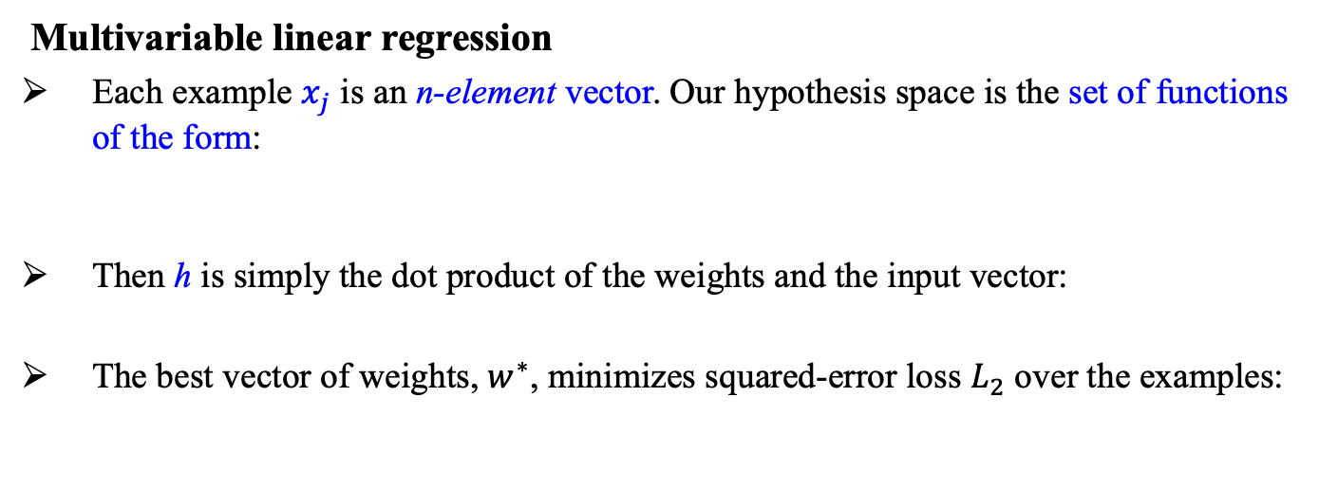
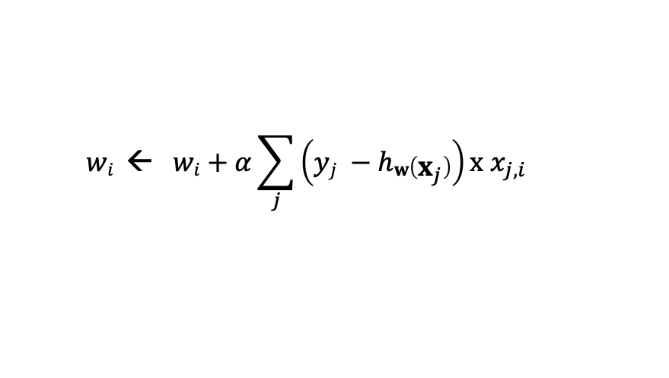
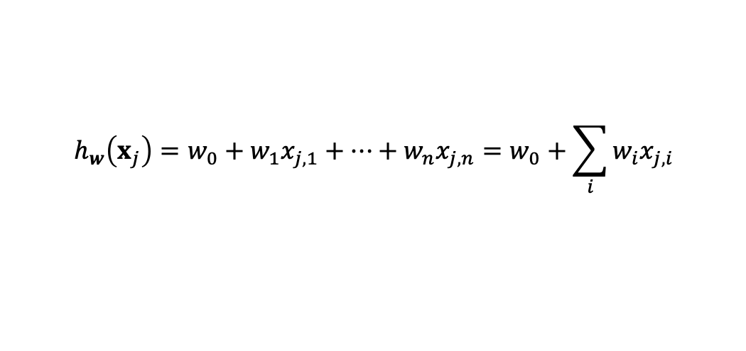
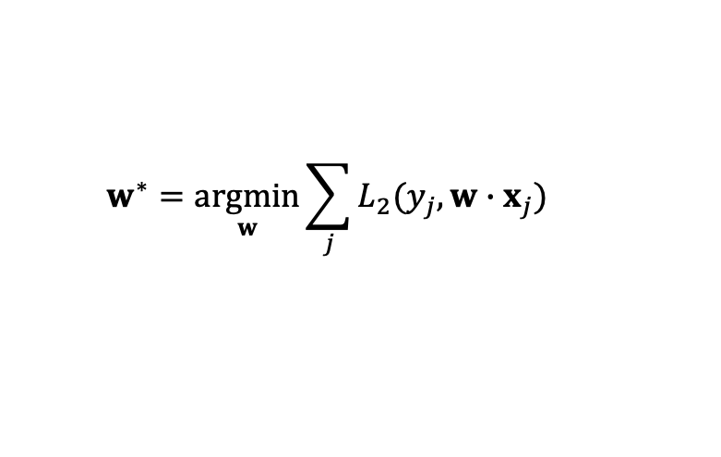
15.5 Linear Regression and Classification (6/10)
Multivariable linear regression
Each example $x_{j}$ is an n-element vector. Our hypothesis space is the set of functions of the form:
Then h is simply the dot product of the weights and the input vector:
The best vector of weights, $w^{∗}$, minimizes squared-error loss $L_{2}$ over the examples:
$$h_{w}\left(x_{j}\right)=w_{0}+w_{1}x_{j,1}+⋯+w_{n}x_{j,n}=w_{0}+\sum_{i}{w_{i}x_{j,i}}$$
$h_{w}(x_{j}$) = $w∙x_{j}$ = $w^{⊤}x_{j}$ = $\sum_{i}{w_{i}x_{j,i}}$
$$w^{∗}=\underset{w}{argmin}{\sum_{j}{L_{2}(y_{j},w∙x_{j})}}$$
$$wi \text{←} wi+α\sum_{j}{\left(yj −hw\left(x_{j}\right)\right)x{ x}_{j,i}}$$

Slide 35
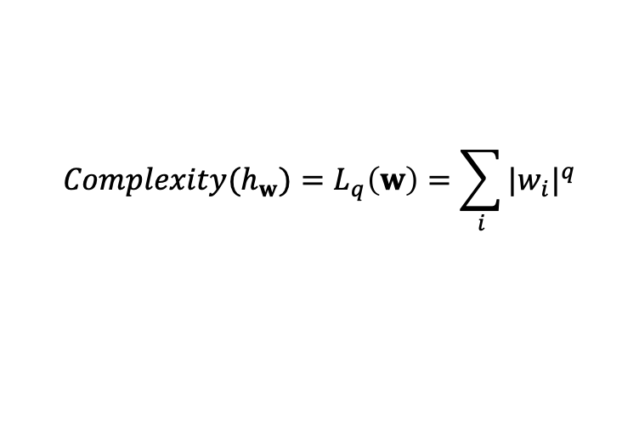
15.5 Linear Regression and Classification (7/10)
Overfitting and regularization
With multivariable linear regression in high-dimensional spaces, it is possible that some dimension that is actually irrelevant appears by chance to be useful, resulting in overfitting
Thus, it is common to use regularization on multivariable linear functions to avoid overfitting
For linear functions the complexity can be specified as a function of the weights. We can consider a family of regularization functions:
$${Complexity(h}_{w})=L_{q}\left(w\right)=\sum_{i}{{|w_{i}|}^{q}}$$

Slide 36
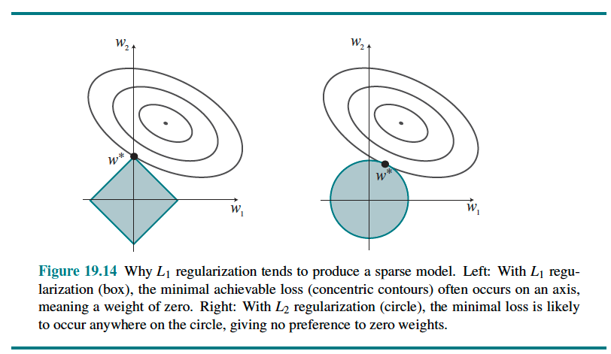
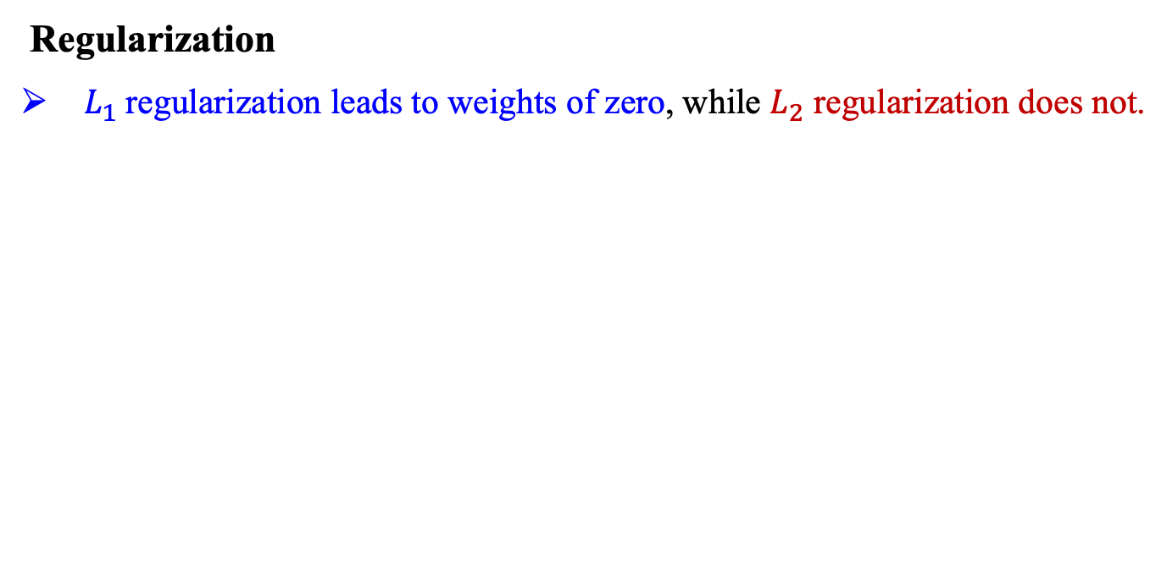
15.5 Linear Regression and Classification (8/10)
Regularization
$L_{1}$regularization leads to weights of zero, while $L_{2}$ regularization does not.
<출처> Stuart J. Russell and Peter Norvig (2021). Artificial Intelligence: A Modern Approach (4th Edition). Pearson

Slide 37
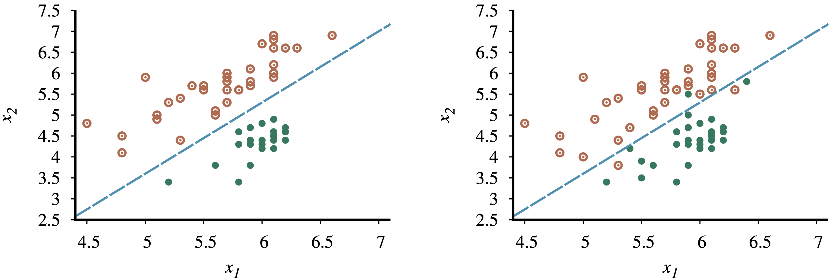
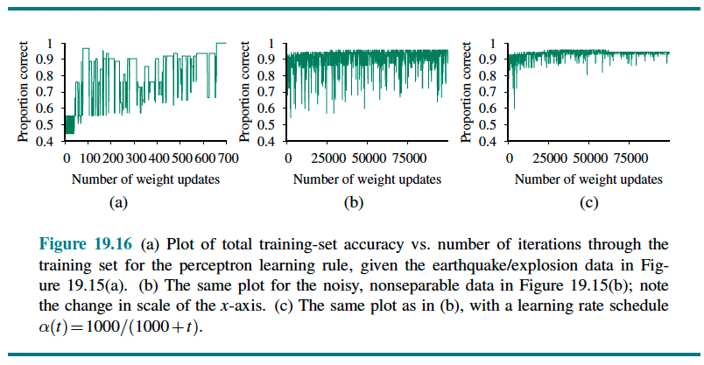
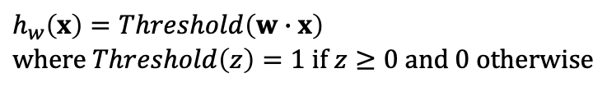
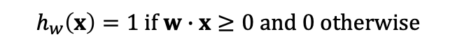
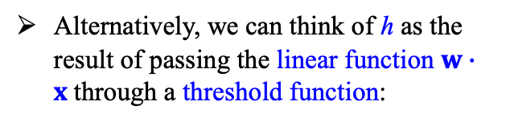
15.5 Linear Regression and Classification (9/10)
Linear classifiers with a hard threshold
Linear functions can be used to do classification as well as regression.
$$h_{w}\left(x\right)=1 if w∙x≥0 and 0 otherwise$$
Data points of two classes: earthquakes and underground explosions
Alternatively, we can think of h as the result of passing the linear function $w∙x$through a threshold function:
$$h_{w}\left(x\right)=Threshold\left(w∙x\right)$$
$$where Threshold\left(z\right)=1 if z≥0 and 0 otherwise$$

Slide 38
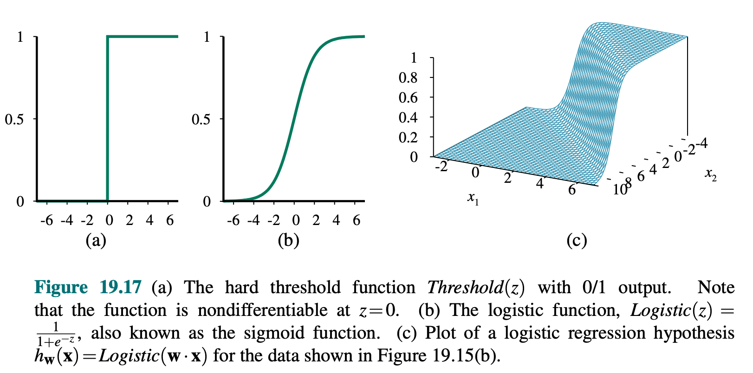

15.5 Linear Regression and Classification (10/10)
Linear classifiers with logistic regression
$$h_{w}\left(x\right)=Logistic(w∙x)=\frac{1}{1+exp(−w∙x)}$$

Slide 39
15.6 Nonparametric Models

Slide 40
15.6 Nonparametric Models (1/5)
Nonparametric models
A nonparametric model is one that cannot be characterized by a bounded set of parameters
The problem with this method is that it does not generalize well
<출처> Stuart J. Russell and Peter Norvig (2021). Artificial Intelligence: A Modern Approach (4th Edition). Pearson

Slide 41



15.6 Nonparametric Models (2/5)
Nearest-neighbor models
Given a query $x_{q}$, instead of finding an example that is equal to $x_{q}$, find the k examples that are nearest to $x_{q}$. This is called k-nearest-neighbors lookup.
Distances are measured with a Minkowski distance or $L^{p}$ norm, defined as:
$$L^{p}\left(x_{j},x_{q}\right)=(\sum_{i}{{{{|x}_{j,i}−x_{q,i}|}^{p})}^{1/p}}$$
In low-dimensional spaces with plenty of data, nearest neighbors works very well: we are likely to have enough nearby data points to get a good answer. But as the number of dimensions rises we encounter a problem (curse of dimensionality).

Slide 42

15.6 Nonparametric Models (3/5)
Nonparametric regression
K-nearest-neighbors regression improves on connect-the-dots.
Locally weighted regression (Figure 19.20(d)) gives us the advantages of nearest neighbors, without the discontinuities.
<출처> Stuart J. Russell and Peter Norvig (2021). Artificial Intelligence: A Modern Approach (4th Edition). Pearson

Slide 43




15.6 Nonparametric Models (4/5)
Support vector machines
SVMs construct a maximum margin separator—a decision boundary with the largest possible distance to example points. This helps them generalize well.
SVMs create a linear separating hyperplane, but they have the ability to embed the data into a higher-dimensional space, using the so-called kernel trick.

Slide 44


15.6 Nonparametric Models (5/5)
The kernel trick
The kernel method implicitly transform the input data into a high-dimensional space where a linear separator may exist, even if the original data are nonseparable.
The dot product is replaced by a kernel function and we have a kernelized version of the algorithm (kernelization)

Slide 45
15.7 Ensemble Learning

Slide 46


15.7 Ensemble Learning (1/7)
What is ensemble learning?
The idea of ensemble learning is to select a collection, or ensemble, of hypotheses, $h_{1},h_{2},…,h_{n}$, and combine their predictions by averaging, voting, or by another level of machine learning. We call the individual hypotheses base models and their combination an ensemble model.
Two reasons of ensemble learning
1) The first is to reduce bias.
2) The second reason is to reduce variance.

Slide 47

15.7 Ensemble Learning (2/7)
Ensemble of linear classifiers
An ensemble of three linear classifiers (Figure 19.23) can represent a triangular region that could not be represented by a single linear classifier.
An ensemble of n linear classifiers allows more functions to be realizable.
<출처> Stuart J. Russell and Peter Norvig (2021). Artificial Intelligence: A Modern Approach (4th Edition). Pearson

Slide 48

15.7 Ensemble Learning (3/7)
Bagging
In bagging, we generate K distinct training sets by sampling with replacement from the original training set.
Bagging tends to reduce variance and is a standard approach when there is limited data or when the base model is seen to be overfitting.

Slide 49

15.7 Ensemble Learning (4/7)
Random forests
The random forest model is a form of decision tree bagging in which we take extra steps to make the ensemble of K trees more diverse, to reduce variance.
Random forests can be used for classification or regression.
The key idea is to randomly vary the attribute choices (rather than the training examples).

Slide 50

15.7 Ensemble Learning (5/7)
Stacking
Whereas bagging combines multiple base models of the same model class trained on different data,
Stacking (or stacked generalization) combines multiple base models from different model classes trained on the same data.

Slide 51


15.7 Ensemble Learning (6/7)
Boosting
The most popular ensemble method is called boosting.
Weighted training set, in which each example has an associated weight $W_{j}≥0$that describes how much the example should count during training.
<출처> Stuart J. Russell and Peter Norvig (2021). Artificial Intelligence: A Modern Approach (4th Edition). Pearson

Slide 52

15.7 Ensemble Learning (7/7)
Boosting
An interesting thing happens as the ensemble size K increases.
Figure 19.26(b) shows the training set performance (on 100 examples) as a function of K
<출처> Stuart J. Russell and Peter Norvig (2021). Artificial Intelligence: A Modern Approach (4th Edition). Pearson

Slide 53
Summary
If the available feedback provides the correct answer for example inputs, then the learning problem is called supervised learning. The task is to learn a function 𝑦 = ℎ(𝑥).
Learning a discrete-valued function is called classification; learning a continuous function is called regression.
Inductive learning involves finding a hypothesis that agrees well with the examples.
Decision trees can represent all Boolean functions. The Information-gain heuristic provides an efficient method for finding a simple, consistent decision tree.
The performance of a learning algorithm is measured by the learning curve, which shows the prediction accuracy on the test set as a function of the training-set size. When there are multiple models to choose from, cross-validation can be used to select a model that will generalize well.
Sometimes not all errors are equal. A loss function tells us how bad each error is; the goal is then to minimize loss over a validation set.
Computational learning theory analyzes the sample complexity and computational complexity of inductive learning. There is a tradeoff between the expressiveness of the hypothesis space and the ease of learning.

Slide 54
Summary
Linear regression is a widely used model. The optimal parameters of a linear regression model can be calculated exactly, or can be found by gradient descent search, which is a technique that can be applied to models that do not have a closed-form solution.
A linear classifier with a hard threshold—also known as a perceptron—can be trained by a simple weight update rule to fit data that are linearly separable. In other cases, the rule fails to converge.
Logistic regression replaces the perceptron’s hard threshold with a soft threshold defined by a logistic function. Gradient descent works well even for noisy data that are not linearly separable.
Nonparametric models use all the data to make each prediction, rather than trying to summarize the data with a few parameters. Examples include nearest neighbors and locally weighted regression.
Support vector machines find linear separators with maximum margin to improve the generalization performance of the classifier. Kernel methods implicitly transform the input data into a high-dimensional space where a linear separator may exist, even if the original data are nonseparable.
Ensemble methods such as bagging and boosting often perform better than individual methods. In online learning we can aggregate the opinions of experts to come arbitrarily close to the best expert’s performance, even when the distribution of the data are constantly shifting.

